Slide 1
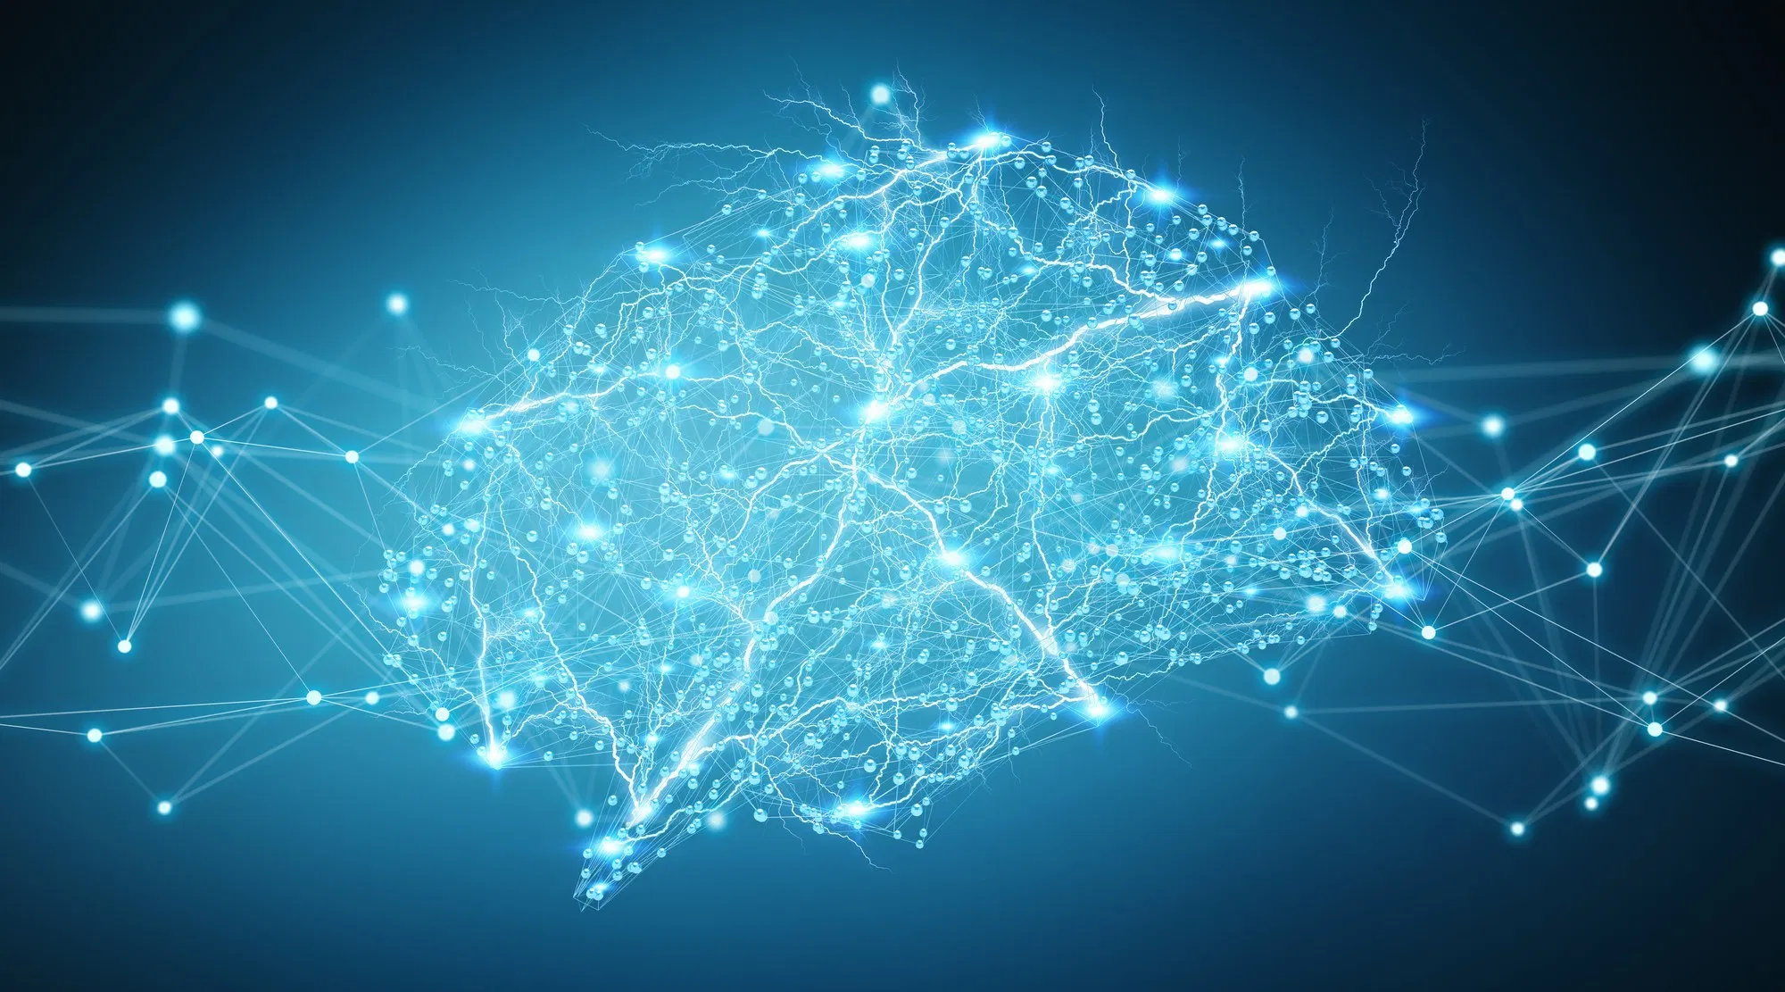
DL201+
A Deep Learning Workshop
Day 1
Benjamin Chew | Kok Zhao Jie | Shaun Tieon

Slide 2
Some admin stuff
Please rmb to complete the quiz, just google or ask people but don’t copy
It’s meant to serve as a short prereq for the content we cover
Jot down any questions or ideas u have, they’ll become quite useful as u continue doing deep learning
Make sure u have the notebook and datasets (or libraries) ready by lunch, we may not have time to help u do your set up

Slide 3
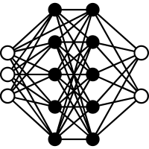

Deep learning vs Classical Machine Learning
Deep Learning
Classical Machine Learning
Machine learning with deep neural nets
Better suited for complex tasks
“Simplistic” mathematical functions that describe your inputs
Sufficient for simplistic tasks

Slide 4
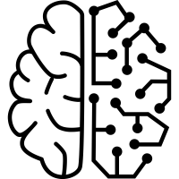
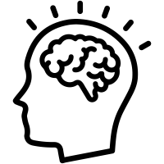
What is learning?
Human
Machine
We ourselves do not know, but it should be something to do with neurons
We try to model it as best we can
Something to do with learning from experiences or knowledge
A self correcting mathematical function

Slide 5
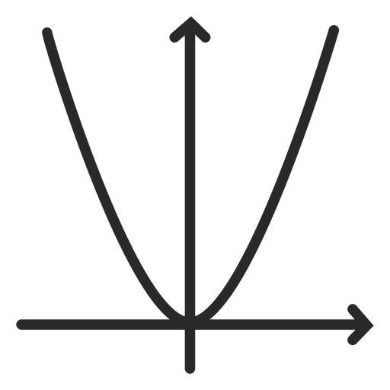





How do humans & machines learn?
Human
Math/Machine approximation
By being able to tell right from wrong
Associate some “cost” to being wrong, something like an exam for our approximation (i.e: a loss function)
By becoming better at finding the correct answer/Improving your skills
Have some way to adjust our approximation to minimise the loss function (usually through gradient descent mechanisms)
By reading notes or practising or having exposure to different scenarios
Expose our approximation to various cases available (Simply feed the machine with lots of data!)

Slide 6

Overarching idea of a Neural Network
Applying importance to ideas/concepts in person
Weighting/Shifting neurons in math
Human Perception/
Understanding
Some Biological
Witchcraft
Real world events
Thoughts and reflections
Learning
Forward pass/ Activation of neurons
Adjusting function parameters
Data inputs
Calculation of loss

Slide 7

Neurons (in the brain)
Biological neurons communicate with each other and aggregate their signals
Hence, neurons usually get their inputs from other neurons
Inputs from other neurons may or may not be equal
Some other biological function amplifies the aggregated signals from other neurons
Signals are passed from neuron to neuron, possibly in groups

Slide 8



Neurons (in the brain)
Hence our function now needs to do 3 things to get input
Get the inputs from other neurons and have some way to give different importance to each one
Have some way to amplify (or dampen) the signal
Simulate the way neurons send signals sequentially and in groups

Slide 9

Neurons (as a function)
Layer 1
Layer 2
n₁
w₁*n₁(x) + b₁
Input: X
Output: X̂
n₂
w₂*n₂(x) + b₂
N_{i}
X̂ = N_{i}(w₁*n₁(x) + b₁ + w₂*n₂(x) + b₂ + w₃*n₃(x) + b₃)
n₃
w₃*n₃(x) + b₃
We assign importance to each input going into N_{i} by multiplying the output from each previous neuron by some weight w
We can amplify or dampen the output of each input going into N_{i} by w, or by adjusting the value of the bias b
We can have the sequential and grouping nature of neurons by having multiple layers of neurons
Notes:
Use matrix multiplication to explain

Slide 10


Measuring Learning
Able to retrieve some output based on some input
I.e: our model can now “perceive” inputs that are provided
Need some way to quantify if the perception is correct
But correctness may be subjective, so we instead measure how wrong the model is
Need some function that measures the level of wrongness the model has
Loss Function

Slide 11




Measuring Learning
Having the loss function is not enough to help our model learn
Doesn’t matter how wrong you know your answer if you don’t have resources to guide you in the right direction
Need an efficient mechanism to guide our model’s learning (Minimize loss)
Since loss is a function in terms of model parameters, we can just use the gradients w.r.t the model parameters

Slide 12
Measuring Learning - Some Common Functions
Most machine learning problems can be grouped under 2 main types
Classification
Regression
Assigning categories to an input
Can be single or multi-label
Predicting a trend by looking at available data
Generally extrapolative in deep learning, but can also be interpolative

Slide 13
Measuring Learning - Some Common Functions
Most machine learning problems can be grouped under 2 main types
Classification
Regression
Almost always involves cross-entropy
Aims to maximise model confidence in producing the correct label
Predicting a trend by looking at available data
Generally extrapolative in deep learning, but can also be interpolative

Slide 14
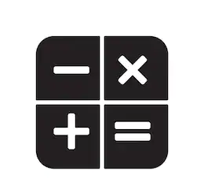
Measuring Learning - some math
X̂ = N_{i}(w₁*n₁(x) + b₁ + w₂*n₂(x) + b₂ + w₃*n₃(x) + b₃)
Remember that we want to emulate the way humans learn by improving our skills
Notice how the output is a chain of functions? X̂ = N(n(input))
Hence if we have loss function L:X̂ |-> ℝ
We can adjust the value of L by changing the values of the w’s and the b’s (by chain rule)
*Note that we differentiate L w.r.t w and b, not x (since our input x needs to “guide” our learning)
Rog but how does the model improve exactly?
Since we have the L in terms of the weights and biases, we slightly adjust each one to try and make L smaller
Since we want to find a minimum of L, we shift our function in the direction that lets L decrease the most
i.e : adjust each weight and bias in the negative direction of the derivative of L (hence the name gradient descent)
Notes:
Speaker explain the note by showing that the derivative is in terms of x

Slide 15
Individual neurons
Biological Neurons
DL Neurons
Biological neurons work by fire/activation when given some stimuli
Implies they have some state/action that changes based on some input
Also means neurons aren’t always firing → Able to differentiate between good/bad stimulus or have some threshold that the stimulus must overcome
Function that models neurons have 2 objectives
Stimulate neurons firing/reacting to stimulus
Be able to filter out “bad” signals that fall below some threshold

Slide 16
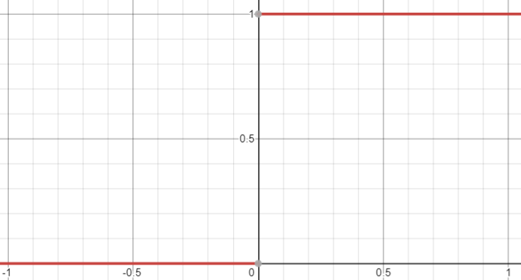
Neuron (function)
Suppose we set the threshold to 0, and we use binary states to represent a neuron firing. We can basically represent a neuron with a stepwise function
So problem solved right?
Diip lurning hurhur
But this graph kinda sucks because its discontinuous and has doesn’t really have a gradient (rmb that u need gradient for gradient descent)

Slide 17
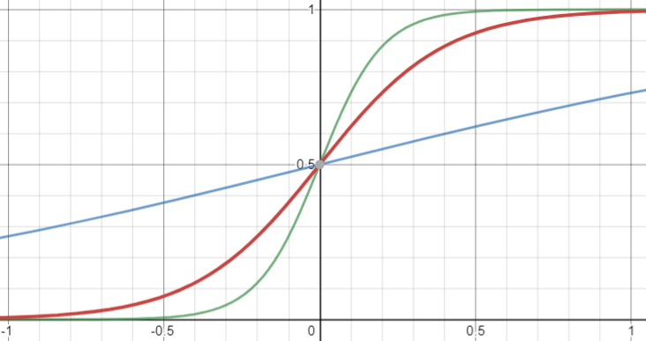

Neuron (function)
But stepwise kinda sucks because its discontinuous, doesn’t really have a gradient (rmb that u need gradient for gradient descent), and also binary states may not work well in math
So instead, a sigmoid is usually used since it is continuous
*Note that the graph becomes steeper as n increases but we usually don’t care
Ok so the threshold problem and continuity is fixed but how about corresponding to the output

Slide 18
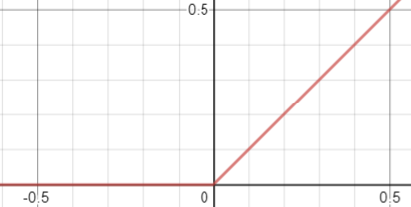
Neuron (function)
Once again sigmoid is imperfect. Since we want to have something that corresponds to the output, then how about something that’s 0 for x<0, and linear for x>0.
We want a ReLU
*Note that the graph is discontinuous at x=0 but since x=0 input is rare we don’t need to worry
*Note that this is far from perfect but still useful. For those interested GeLU and leaky ReLU are good places to start reading
Ok so output settle but input how??

Slide 19



Problems with learning
Since we are emulating the way humans learn, our model also ends up emulating some problems that humans face when learning
Important to be able to detect (and fix whenever possible) these problems that our model will face
Human Problems
Machine Terms
Disproportionate exposure to learning materials
Class imbalance in training/testing data
Jumping to conclusions/Memorising
Overfitting/Local Minima
Difficulty Learning
Underfitting

Slide 20



Problems with learning
Class imbalance in training/testing data
Problems arising from imbalance
Model results skew towards or against a portion of the data
Often a data issue (doesn’t mean it always is)
Identifying Imbalanced learning
Use metrics that account for balance such as f-measures or ROC-AUC
Fixing imbalanced learning
Upsampling (create more samples for the minority class)
Downsampling (take fewer samples from the majority class)
Weighted-Losses (weight each loss in training based on the class of the input or some other function)
Identify and remove/emphasise out-of-distribution samples (advanced)

Slide 21
Problems with learning
Overfitting
Problems arising from models being unable to generalise based on training set
Model learns to do well on the training set instead of how to do well on the task in general
Identifying Overfitting
Training performance >>> validation/testing performance
Fixing Overfitting
Regularisation -> penalise the model’s learning process to inhibit its learning
Telling the model to chill
Normalisation -> adjust/rescale “inputs” to reduce their impact on the model
Changing the model’s “perspective” of each input
Dropouts -> randomly ignore some neurons during training
Kinda like forcing the model to rely less on “bad” neurons to remove “assumptions”

Slide 22
Problems with learning
Underfitting
Problems arising from models being unable to learn at all
Model fails to perform even on training set
Identifying Underfitting
Model performance stagnates
Low performance even on training
*NOTE: training performance < validation performance doesn’t necessarily mean underfitting
Fixing Underfitting
Use a different architecture
Changing the model’s “understanding” of the data
Reduce regularisation and normalisation
Change/Schedule learning
Pace the rate at which the model is learning
Residual Connections → link outputs of early neurons to later neurons
Allow the model to “revise early concepts”

